Slide 1
TOPIC A:
DATABASES
LESSON A-16
EXTRACT, TRANSFORM, LOAD

Slide 2
AGENDA
Need for ETL
Extract
Transform
Load
Transformation Lab
NOTE!
Have a way to take notes available for this lesson

Slide 3

THE WARM UP QUESTION
Given the two pieces of information about one person:
Source A – Name: J. Smith, DOB: 1/12/1990, Spend: £50
Source B – Name: John Smith, DOB: 1990-12-01, Spend $60
What happens if a computer sums these up?
What could be done to sum them?

Slide 4
THE WARM UP ANSWER
Source A – Name: J. Smith, DOB: 1/12/1990, Spend: £50
Source B – Name: John Smith, DOB: 1990-12-01, Spend $60
While we know both of these are the same person, the computer doesn’t
ETL is the process of ensuring different syntax formats represent the same thing
We would need to convert both of these into the same format to add them

Slide 5
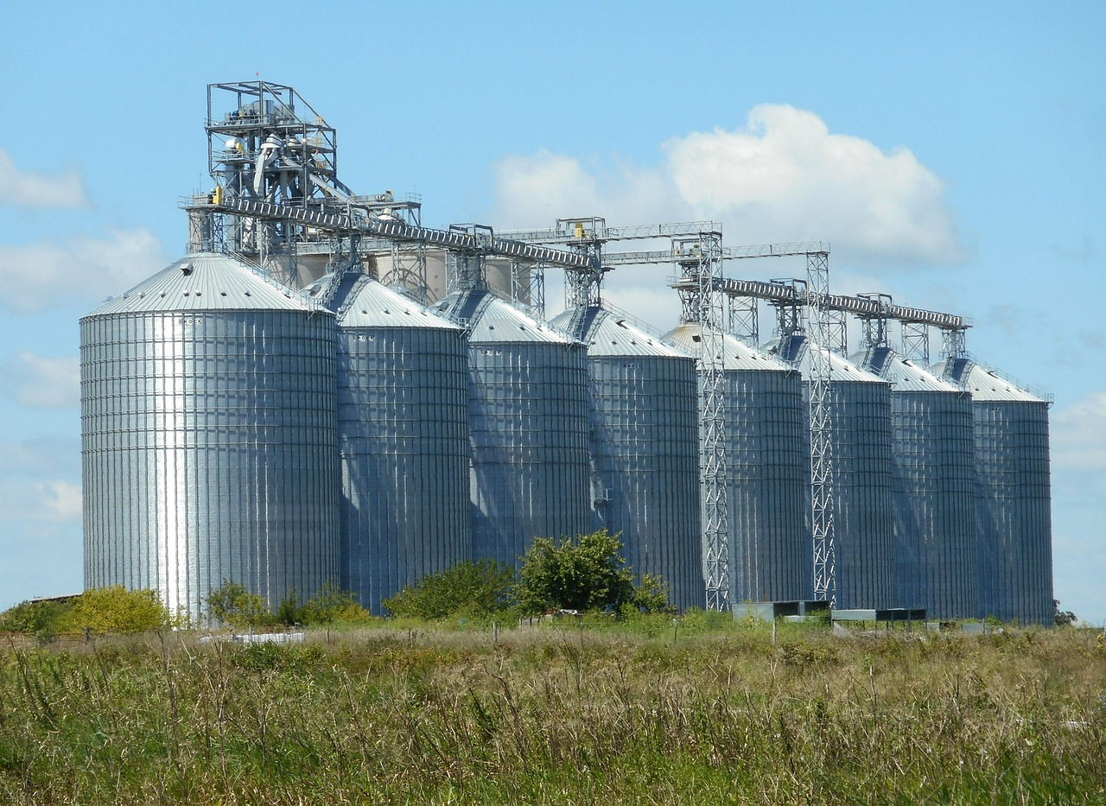
THE NEED FOR ETL
Operational data can be messy and siloed
Meaning that the way it’s collected can vary by location or type of data
To perform specialized processing in a data warehouse we need a pipeline for the data
ETL:
Extract
Transform
Load

Slide 6

EXTRACT
Extract – the process of reading data from various disparate sources
Sources may include:
SQL Database
CSV Files/Excel Sheets
Social Media APIs
The data from these sources is unlikely to be in the same format, which is why we need…

Slide 7

TRANSFORM
Transform – Data is modified, filtered, and converted into a uniform format
This is by far the most complex stage
Often referred to as data “cleaning”
Invalid data is not included, or modified to be compliant

Slide 8
LOAD
Load – The newly uniform data is written into the data warehouse
From there, it can be stored permanently
When it’s in the data warehouse, it can then be used for analysis

Slide 9
ETL PRACTICE
Go to GitHub and download the Lesson A-16 – ETL Practice Spreadsheet
We’re going to be transforming the data in this spreadsheet into a consistent format that could go into a data warehouse
What are three reasons that we can’t add it to the data warehouse already?

Slide 10
ETL PRACTICE
What are some rules we might be able to use to clean some of this data?

Slide 11
ETL PRACTICE
Example rules:
If Name contains ‘,’ then reverse and remove comma
If Gender starts with F then set to Female
Convert GBP to USD using rate 1.34
Convert all to YYYY-MM-DD format

Slide 12
ETL PRACTICE
What should we do with the data that is blank?

Slide 13
ETL PRACTICE
Now finish cleaning up the table into a consistent format

Slide 14
WHY ETL?
ETL is important for a few reasons:
Data integrity: ensures that decisions are being made with most up-to-date and consistent data available
Specialized processing: Warehouse is optimized for reading
We should transform the data each time we add it (once) instead of each time we get it (multiple times over)
Queries are much faster because of this.

Slide 15
LAB QUESTION
Explain the transform stage of the ETL process
Describe how ETL processes can be used to clean up data when merging two databases from different countries [2]

Slide 16
LAB QUESTION
Explain the transform stage of the ETL process
Award 1 mark for: Identifying a specific inconsistency (e.g., currency, date formats, or naming conventions).
Describe how ETL processes can be used to clean up data when merging two databases from different countries [2]
Award 1 mark for: Identifying a specific inconsistency (e.g., currency, date formats, or naming conventions).
Award 1 mark for: Explaining that the ETL process applies rules to convert these into a single standard so that analysis/comparisons are accurate.

Slide 17
SHORT ETL WS
There’s a short ETL worksheet available on Github, good luck!

Slide 18

VOCAB TO REMEMBER
Extract
Transform
Load

